Slide 1

Maharashtra Institute of Technology (Mechanical department)
Project :- DESIGN AND ANALYSIS OF TWO STAGE GEARBOX IN ATV VEHICLE .
Project by:-
Guide:-
Prof. P.S. Kulkarni
Chetan Madhav Chahakar[TYMA12]
Sagar Sanjay Aware [TYMA13]
Darshan Kailas Balshete [TYMA 34]

Slide 2
CONTENTS
Introduction
Literature review
Problem statement
Methodology of Work
Material Selection
Gear Design
Conclusion

Slide 3
Introduction
Introduction:-
The essential part while considering a vehicle for any of the application is their moment. The required moment of a vehicle is attained due to the power which is produced by an engine.
But the most important aspect is that the produced power should also pass to the various parts of a vehicle.
Here we are considering two stage full depth gearbox for transmission of power from engine to the wheels.
The selection of each element and their materials is characterized by the various parameters like
1. Required power
2. Ultimate Tensile Strength
3. Selection of material

Slide 4
Literature Review
The basic information regarding to the issue is been collected from Team Wings from baja team.
We have studied the literatures available on internet
Also there are lots of videos available on YouTube which really helps us to understood the problem and solution overcome that.
Sr.No | Author Name | Parameter
1. | L. Karikalan, K. Mathan | Proper material selection 3D Modeling in NX Software In analysis of gears and casing done with a static structural heat flux, Stress & Strain analysis
2. | V.Pranay Deepak Reddy | Static structural analysis on Pinion & Gear Vibration analysis

Slide 5
Objectives of the this work
Objectives are
To have a safe design in order to attain the maximum possible output.
To obtained the Failure previously should avoided by using appropriate mathematical approach.
To reduce Cost of work should be limited up to-certain limit.
To Applying the sustainable mechanical elements in a previously designed system

Slide 6
Problem statement
In ATV Vehicle gearbox is failed due to the unbalanced forces exerted on the shaft . The shaft exceeded the limit due to the improper reaction force provided by the bearing
To select the proper Material for a design of the gears and gearbox casing. To sustain the load which acted on the gears
For a casing of gearbox have a lower thermal conductivity because of power that can be transmitted at ambient temperature without resulting in the damage of inner working

Slide 7
Methodology of work
Longitudinal Dynamics
Transmission Selection
Choosing Optimum Gear Ratio
Transmission Element Design
DFMEA
Block Diagram
Material selection
Power Required
3D Modeling
Gear
Input Pinion
Intermediate Gear
Intermediate pinion
Equivalent
Stress Analysis
Analysis
Gear
Other Side
Brake Side
Integrated Spool
3 D Modeling
Casing
Casing Analyis
Heat Flux & Equivalent Stress

Slide 8
Material selection
Gear Design
Gear Material | EN8
SR. NO | PROPERTIES OF MATERIAL | EN8 MATERIAL
1 | YTS | 575
2 | UTS | 650
As compared with the other high grade materials available the particular selected material is much cost effective and it is a material posses high strength w. r. to other EN grade materials. The proper heat treatment processes also employed in order to occur the maximum possible hardness. The selection also done with respect to machinability of EN8.
Gearbox Casing | Al6082 | Strength Alloy with Excellent Corrosion resistance | High thermal conductivity Better Melting Point, Light Weight
 | Al6061 | Low strength, less corrosion resistant

Slide 9
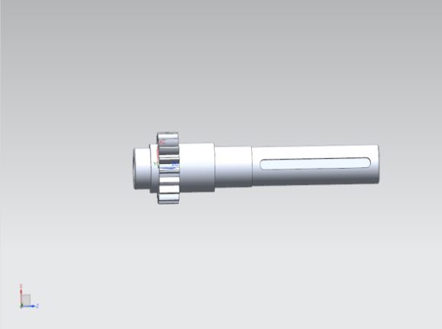
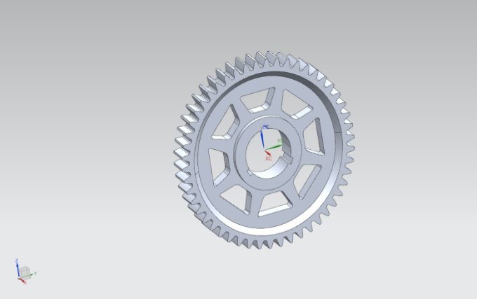
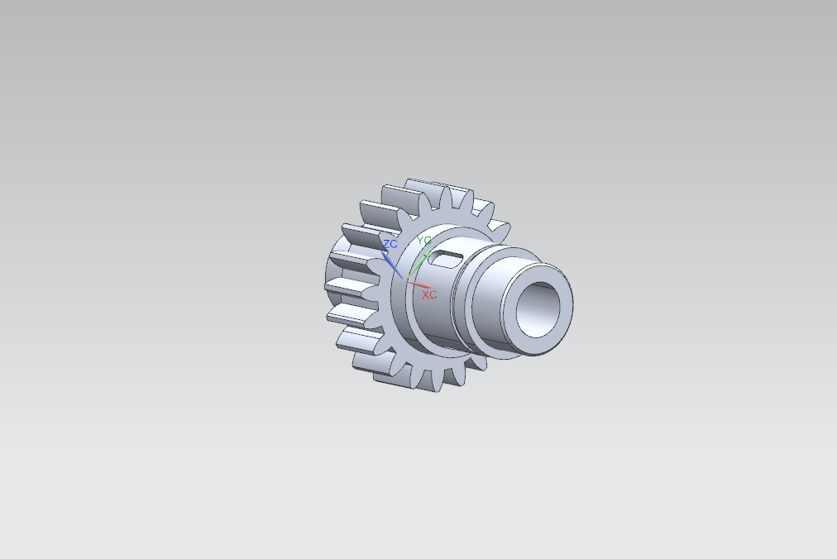
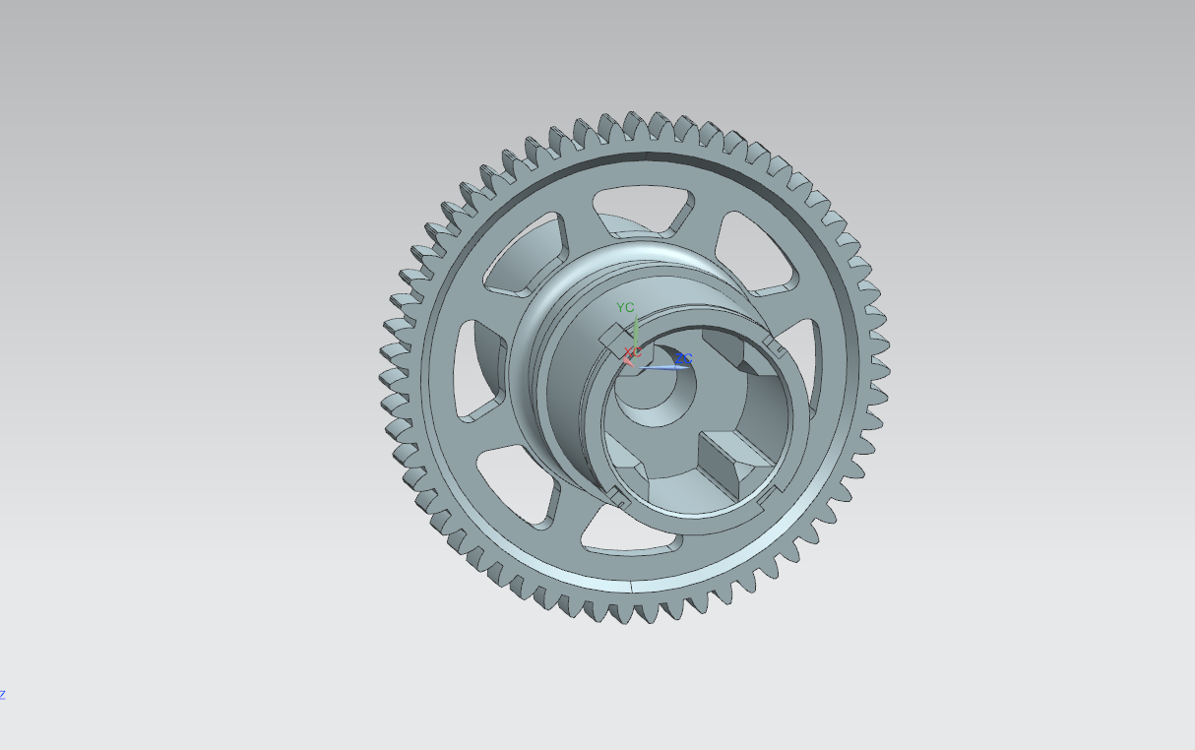
Gear Design
Gear Design:-
From design criteria followed, The most important parameter for gear design i.e. module is found to be as :-
Parameters | Components
 | Input Pinion | Intermediate Gear | Intermediate Pinion | Integrated Spool
No. of Teeth | 18 | 50 | 20 | 59
Module | 1.5 | 1.5 | 2 | 2
PCD | 31.5 | 87.5 | 40 | 118
C/C Distance | 68mm |  | 98.75mm
Input Pinion
Intermediate Gear
Intermediate Pinion
Integrated Spool

Slide 10
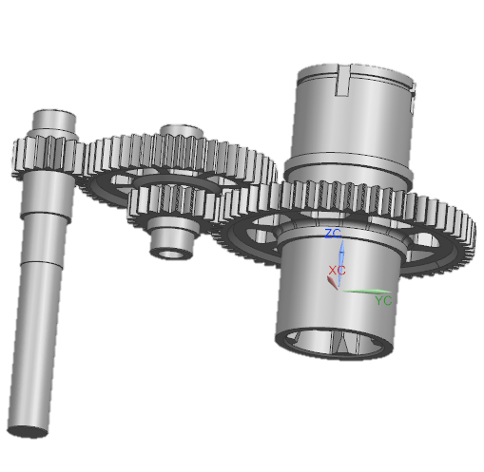
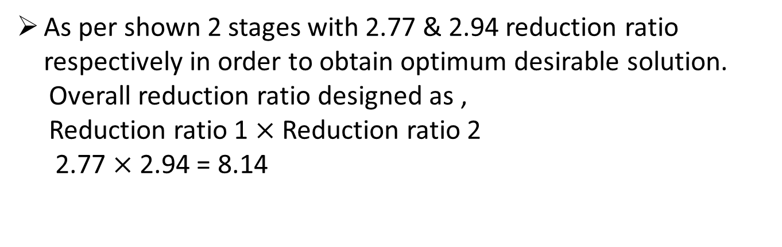
Gear Design
As per shown 2 stages with 2.77 & 2.94 reduction ratio respectively in order to obtain optimum desirable solution.
Overall reduction ratio designed as ,
Reduction ratio 1 $×$ Reduction ratio 2
2.77 $×$ 2.94 = 8.14

Slide 11
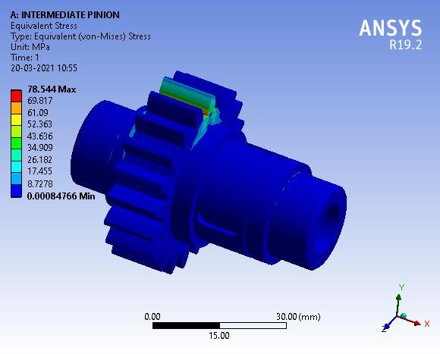
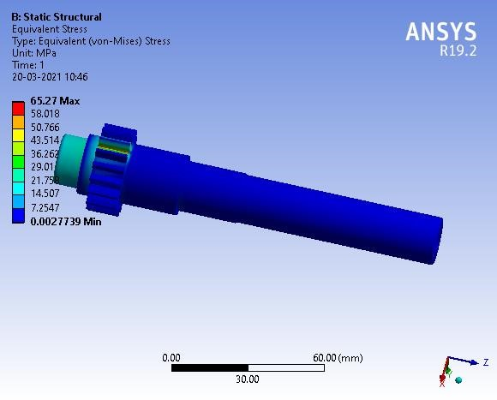
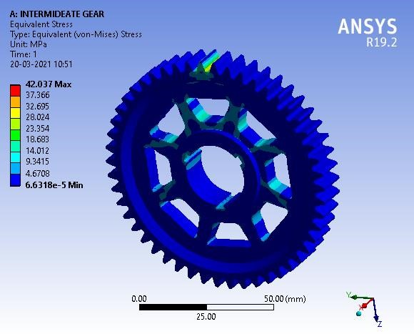
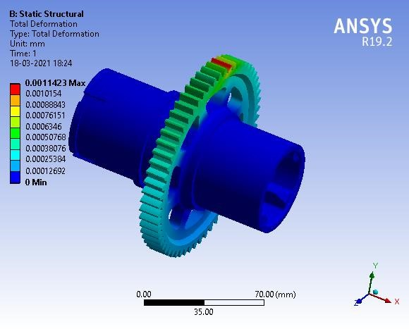
Gear Analysis
In transmission system there are many components to design and analyze that are gear, gear box casing etc. in this CAE process we used 3D mesh as meshing element which has element size of 2mm, 4mm, and 6mm with different physics like thermal analysis, static analysis, bending & torsional analysis and after several iterations, we come to our final conclusion in which we finalize our final gear, axles and axles for wheels etc. In powertrain system we analyzed in two physics which are static structural analysis in which are analyzed for average deformation & stress concentration and in thermal analysis we analyzed for heat transfer from system to surrounding

Slide 12
Conclusion
We have designed a spur gear used in gear box of ATV Vehicle applications using theoretical calculations and modelling of spur gear is done in NX 12 Software.
We have performed Structural analysis on spur gear using EN 8 .
We are using EN 8 Material because of EN 8 has high strength levels compared to normal bright mild steel, due to thermo-mechanical rolling. EN8 is suitable for all round engineering purposes that may require a steel of greater strength.
For safe Design we have change the teeth on the gear to get maximum possible output.
Due to failure of previous gearbox should avoided by using appropriate mathematical approach using shear force diagram and bending moment diagram.

